Slide 1
Welcome to Technical Bootcamp: Day 1

Slide 2

A look into the Day 1 agenda:
Day 1
8:00
Keynote: Welcome, Objectives, Synapse 101
8:15
Demo Walkthrough – MDW in Action
8:45
Break
Please refer to the descriptions below for reference
9:00
Design Presentation: Data Loading & Data Lake Organization
Types of activities:
Attendees will participate in four different types of activities:
10:00
Breakout Activity: Data Lake Design & Security Considerations
11:00
Keynote
Labs
11:15
Break
Build Hands-on: Data Integration Part 1
Presentations
Challenges
Breakout Activity
12:00
Lunch
Location of activities:
Each activity will take place in the following location:
13:00
Design Presentation: Data Transformations
13:30
Q&A Activity: Data Engineering Discussion
14:00
Build Hands-on: Data Integration Part 2
All-up Session: Teams bridge in calendar invite
Breakout Activity: “Meet Now” function in Teams Table Group channel
15:00
Closing
Independent working time: No meeting, working in Spektra labs

Slide 3

Keynote
Taimur Rashid
GM, Data & AI
Customer Success

Slide 4
Azure Synapse 101 & Demonstration
Matt Basile

Slide 5

Break
Please take this time for a short 15 minute break
Relax and come back refreshed for our next activity
If at anytime you require assistance please send a message to the “Need help – ask here” channel in the Microsoft Teams site for this event

Slide 6
Data Loading & Data Lake Organization
CSA03P

Slide 7

Agenda
1 Orchestration
Synapse pipelines
2 Ingest files to tables
Copy versus CTAS
3 Best practices
Various ingest and storage best practices

Slide 8

Azure Synapse Analytics
Limitless analytics service with unmatched time to insight
Artificial Intelligence / Machine Learning / Internet of Things
Intelligent Apps / Business Intelligence
Designed for analytics workloads at any scale
Synapse Analytics
SaaS developer experiences for code free and code first
Experience
Azure Synapse Studio
Platform
Multiple languages suited to different analytics workloads
MANAGEMENT
Languages
MANAGEMENT
SQL
Python
.NET
Java
Scala
R
Integrated analytics runtimes available provisioned and serverless on-demand
SQL Analytics offering T-SQL for batch, streaming and interactive processing
Spark for big data processing with Python, Scala, R and .NET
SECURITY
Form Factors
SECURITY
PROVISIONED
SERVERLESS
MONITORING
Analytics Runtimes
MONITORING
SQL
METASTORE
METASTORE
DATA INTEGRATION
Integrated platform services for, management, security, monitoring, and metastore
Azure
Data Lake Storage
Common Data Model
Enterprise Security
Optimized for Analytics
Data lake integrated and Common Data Model aware

Slide 9
Modern Data Warehouse
INGEST
PREPARE
TRANSFORM & ENRICH
SERVE
VISUALIZE
STORE

Slide 10
Ingest - Orchestration with Pipelines

Slide 11



Components of Orchestration
Trigger
Pipeline
foreach (…)
On demand
Schedule
Data Window
Event
Activity
Activity
Activity
Activity
Activity
Self-hosted
Integration Runtime
Azure
Integration Runtime
Linked
Service
LEGEND
On-prem
Apps & Data
Azure Services
Command and Control
Data

Slide 12
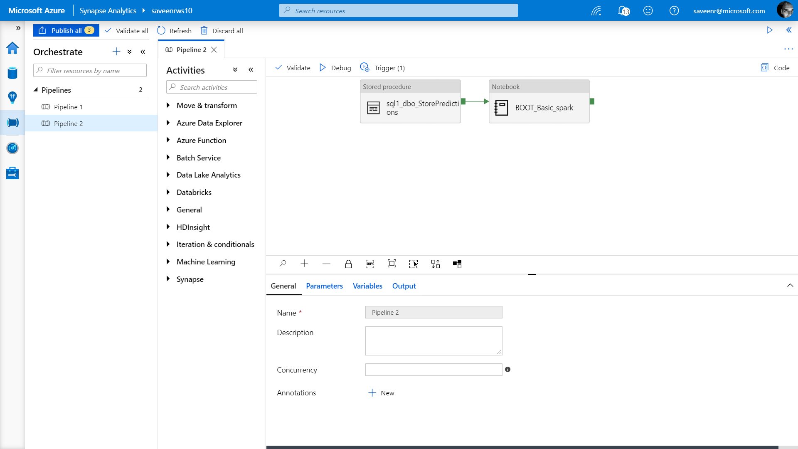
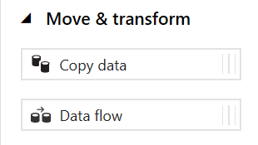
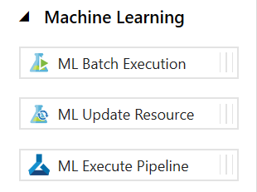
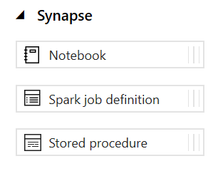
Pipelines
Create pipelines to ingest, transform and load data with 90+ inbuilt connectors.
Offers a wide range of activities that a pipeline can perform.

Slide 13
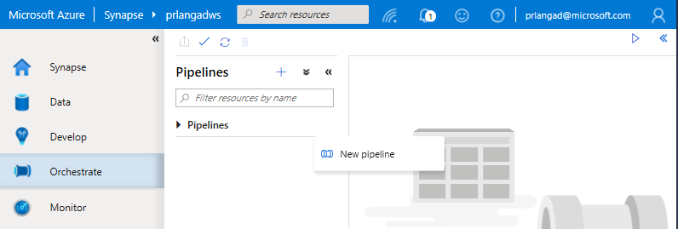
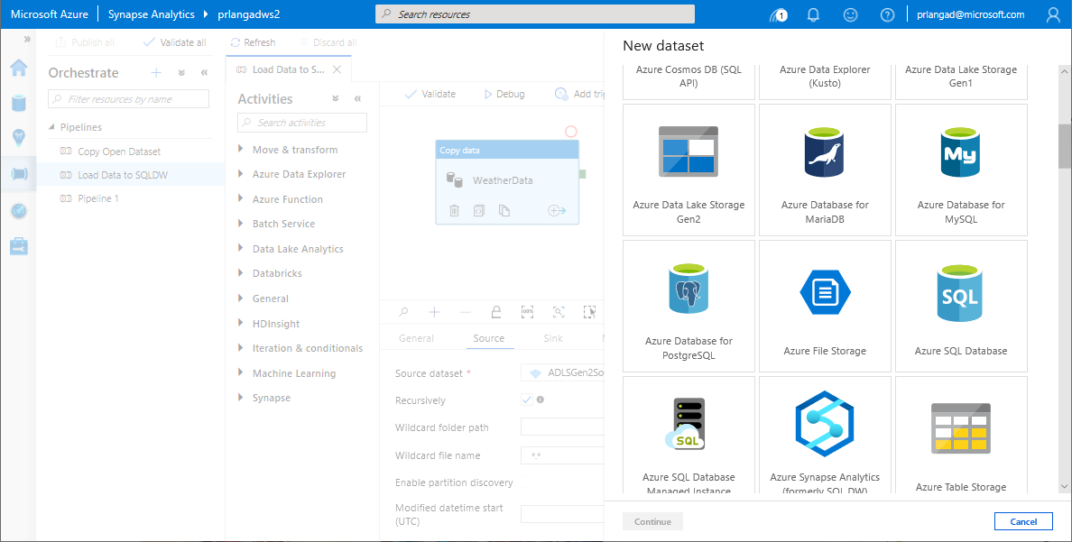
Pipelines
Overview
Provide ability to load data from storage account to desired linked service.
Load data by manual execution of pipeline or by orchestration.
Benefits
Supports common loading patterns.
Fully parallel loading into data lake or SQL tables.
Graphical development experience.

Slide 14
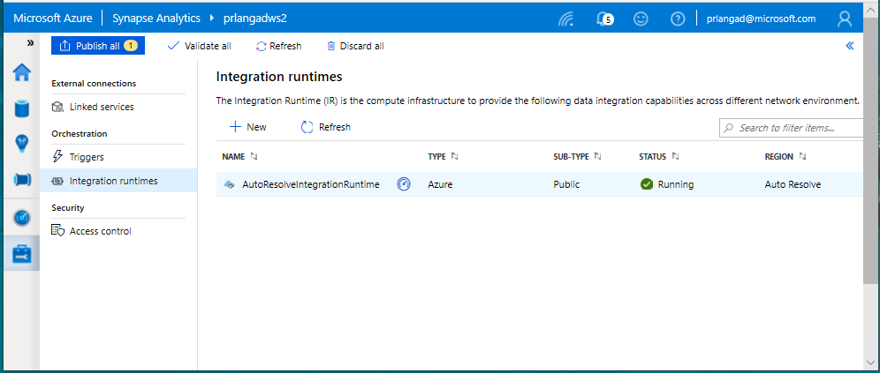
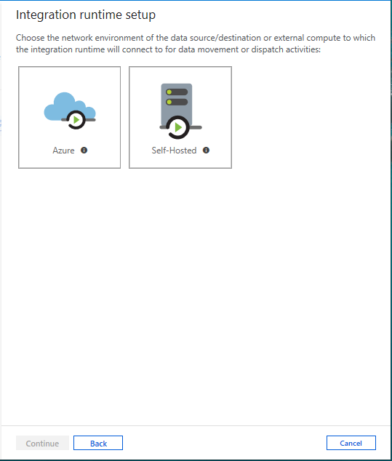
Integration runtimes
Overview
Integration runtimes are the compute infrastructure used by Pipelines to provide the data integration capabilities across different network environments. An integration runtime provides the bridge between the activity and linked services.
Benefits
Offers Azure Integration Runtime or Self-Hosted Integration Runtime
Azure Integration Runtime – provides fully managed, serverless compute in Azure
Self-Hosted Integration Runtime – use compute resources in on-premises machine or a VM inside private network
Notes:
Need to explain and why needed
Check with Gaurav

Slide 15
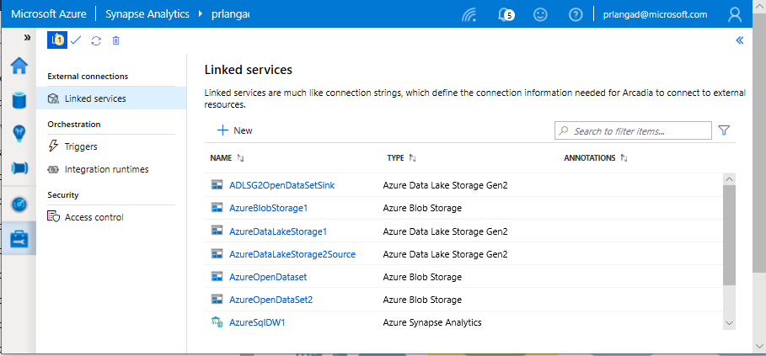
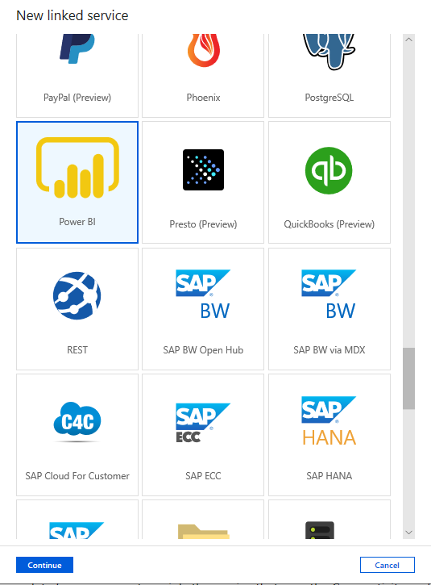
Linked services
Overview
Linked services define the connection information needed to connect to external resources.
Benefits
Offers pre-build 90+ connectors
Easy cross platform data migration
Represents data store or compute resources

Slide 16
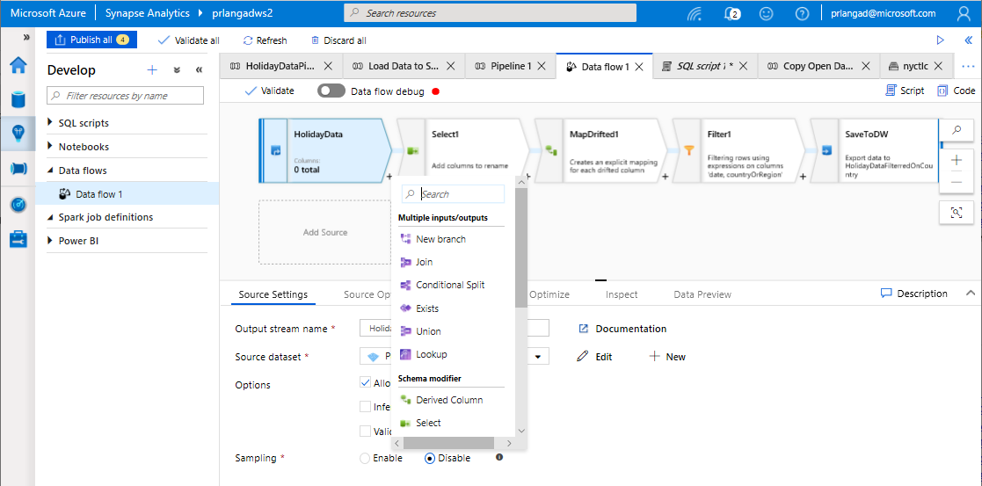
Data Flows
Data flows are pipeline activities providing a visual way of specifying how to transform data.
Provides a code-free experience.

Slide 17
Dataflow Capabilities
Azure Synapse Analytics > Studio > Develop
Handle upserts, updates, deletes on sql sinks
Add new partition methods
Add schema drift support
Add file handling (move files after read, write files to file names described in rows etc)
New inventory of functions (for e.g Hash functions for row comparison)
Commonly used ETL patterns(Sequence generator/Lookup transformation/SCD…)
Data lineage – Capturing sink column lineage & impact analysis(invaluable if this is for enterprise deployment)
Implement commonly used ETL patterns as templates(SCD Type1, Type2, Data Vault)

Slide 18
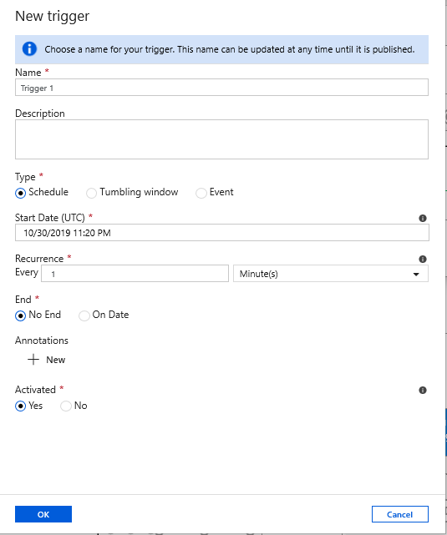
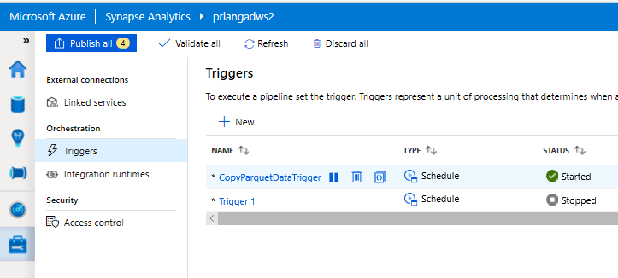
Triggers
Overview
Triggers represent a unit of processing that determines when a pipeline execution needs to be kicked off.
Data Integration offers 3 trigger types as –
Schedule – gets fired at a schedule with information of start date, recurrence, end date
Event – gets fired on specified event
Tumbling window – gets fired at a periodic time interval from a specified start date, while retaining state
It also provides ability to monitor pipeline runs and control trigger execution.

Slide 19
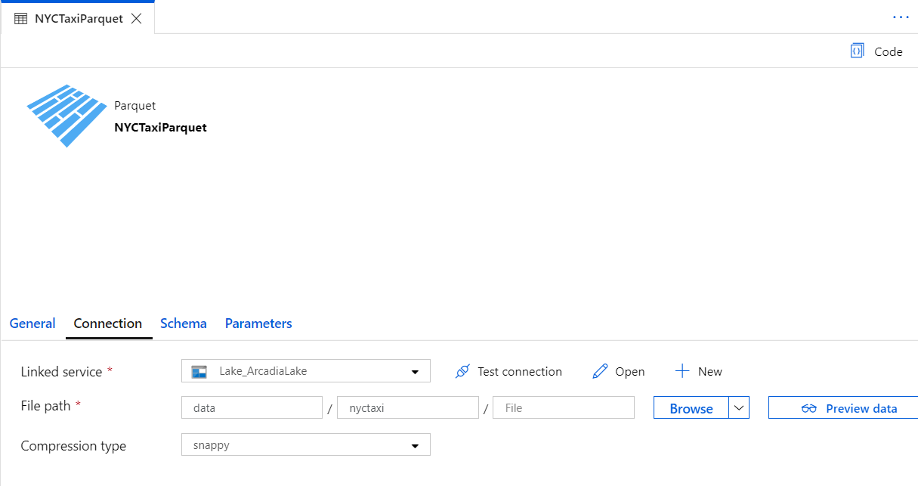
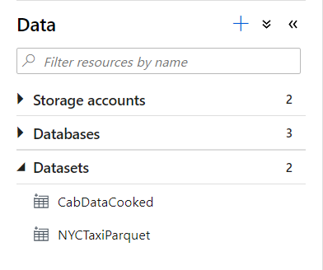
Datasets
Orchestration datasets describe data that is persisted. Once a dataset is defined, it can be used in pipelines and sources of data or as sinks of data.

Slide 20







Data Movement
Scalable
per job elasticity
Up to 4 GB/s
Simple
Visually author or via code (Python, .Net, etc.)
Serverless, no infrastructure to manage
Access all your data
90+ connectors provided and growing (cloud, on premises, SaaS)
Data Movement as a Service: 25 points of presence worldwide
Self-hostable Integration Runtime for hybrid movement

Slide 21
90+ Connectors out of the box
Azure (15) | Database & DW (26) |  | File Storage (6) | File Formats(6) | NoSQL (3) | Services and App (28) |  | Generic (4)
Blob storage | Amazon Redshift | Oracle | Amazon S3 | AVRO | Cassandra | Amazon MWS | Oracle Service Cloud | Generic HTTP
Cosmos DB - SQL API | DB2 | Phoenix | File system | Binary | Couchbase | CDS for Apps | PayPal | Generic OData
Cosmos DB - MongoDB API | Drill | PostgreSQL | FTP | Delimited Text | MongoDB | Concur | QuickBooks | Generic ODBC
Data Explorer | Google BigQuery | Presto | Google Cloud Storage | JSON |  | Dynamics 365 | Salesforce | Generic REST
Data Lake Storage Gen1 | Greenplum | SAP BW Open Hub | HDFS | ORC |  | Dynamics AX | SF Service Cloud
Data Lake Storage Gen2 | HBase | SAP BW via MDX | SFTP | Parquet |  | Dynamics CRM | SF Marketing Cloud
Database for MariaDB | Hive | SAP HANA |  |  |  | Google AdWords | SAP C4C
Database for MySQL | Apache Impala | SAP table |  |  |  | HubSpot | SAP ECC
Database for PostgreSQL | Informix | Spark |  |  |  | Jira | ServiceNow
File Storage | MariaDB | SQL Server |  |  |  | Magento | Shopify
SQL Database | Microsoft Access | Sybase |  |  |  | Marketo | Square
SQL Database MI | MySQL | Teradata |  |  |  | Office 365 | Web table
SQL Data Warehouse | Netezza | Vertica |  |  |  | Oracle Eloqua | Xero
Search index |  |  |  |  |  | Oracle Responsys | Zoho
Table storage
Notes:
formatting

Slide 22
Ingesting files into tables

Slide 23
COPY command
COPY INTO test_1
FROM 'https://XXX.blob.core.windows.net/customerdatasets/test_1.txt'
WITH (
FILE_TYPE = 'CSV',
CREDENTIAL=(IDENTITY= 'Shared Access Signature', SECRET='<Your_SAS_Token>'),
FIELDQUOTE = '"',
FIELDTERMINATOR=';',
ROWTERMINATOR='0X0A',
ENCODING = 'UTF8',
DATEFORMAT = 'ymd',
MAXERRORS = 10,
ERRORFILE = '/errorsfolder/'--path starting from the storage container,
IDENTITY_INSERT
)
Overview
Copies data from source to destination
Benefits
Retrieves data from all files from the folder and all its subfolders.
Supports multiple locations from the same storage account, separated by comma
Supports Azure Data Lake Storage (ADLS) Gen 2 and Azure Blob Storage.
Supports CSV, PARQUET, ORC file formats
COPY INTO test_parquet
FROM 'https://XXX.blob.core.windows.net/customerdatasets/test.parquet'
WITH (
FILE_FORMAT = myFileFormat
CREDENTIAL=(IDENTITY= 'Shared Access Signature', SECRET='<Your_SAS_Token>')
)

Slide 24
Create External Table As Select (Polybase)
-- Create a database master key if one does not already exist
CREATE MASTER KEY ENCRYPTION BY PASSWORD = 'S0me!nfo'
;
-- Create a database scoped credential with Azure storage account key as the secret.
CREATE DATABASE SCOPED CREDENTIAL AzureStorageCredential
WITH
IDENTITY = '<my_account>'
, SECRET = '<azure_storage_account_key>'
;
-- Create an external data source with CREDENTIAL option.
CREATE EXTERNAL DATA SOURCE MyAzureStorage
WITH
( LOCATION = 'wasbs://daily@logs.blob.core.windows.net/'
, CREDENTIAL = AzureStorageCredential
, TYPE = HADOOP
)
-- Create an external file format
CREATE EXTERNAL FILE FORMAT MyAzureCSVFormat
WITH (FORMAT_TYPE = DELIMITEDTEXT,
FORMAT_OPTIONS(
FIELD_TERMINATOR = ',',
FIRST_ROW = 2)
--Create an external table
CREATE EXTERNAL TABLE dbo.FactInternetSalesNew
WITH(
LOCATION = '/files/Customer',
DATA_SOURCE = MyAzureStorage,
FILE_FORMAT = MyAzureCSVFormat
)
AS SELECT T1.* FROM dbo.FactInternetSales T1 JOIN dbo.DimCustomer T2
ON ( T1.CustomerKey = T2.CustomerKey )
OPTION ( HASH JOIN );
Overview
Creates an external table and then exports results of the Select statement. These operations will import data into the database for the duration of the query
Steps:
Create Master Key
Create Credentials
Create External Data Source
Create External Data Format
Create External Table

Slide 25
Polybase vs Copy
Polybase
GA, stable
Needs CONTROL permission
Fastest (at present)
Challenges:
Row width
Delimiters in text
Fixed line delimiter
Code complexity
COPY
Currently in Preview
Relaxed permission
Slightly slower, but improving
No row width limit
Supports delimiters in text
Supports custom column and row delimiters

Slide 26
Best Practices for Ingest

Slide 27
Ingest Flat files to tables
Ingest flat file data into Azure Storage (Azure Data Lake Store Gen2)
When your data sources are on-premises, you need to move the data to Azure Storage before ingestion.
Data in other cloud platforms needs to be moved to Azure Storage before ingestion.
Load from flat files as relational tables within the data warehouse
Notes:
What specific approach would you say is the most efficient way for moving flat file data from the ingest storage locations to the data lake?
Follow the pattern of landing data in the data lake first, then ingest from the flat files into relational tables within the data warehouse. Then create pipelines that extract the source data and store in Azure Data Lake Store Gen2 as Parquet files.
What storage service would you recommend to use?
They should use Azure Data Lake Store (ADLS) Gen2 (Azure Storage with hierarchical file systems).

Slide 28
Ingest - Structuring ADLS Gen2
Separate storage accounts for each environment: dev, test, & production.
Use a common folder structure to organize data by degree of refinement.
ADLS Gen 2 Filesystem
Raw Data
/bronze
Query Ready
/silver
Report Ready
/gold
Notes:
How would you recommend to structure the folder to manage the data at the various levels of refinement?
They should use Azure Data Lake Store (ADLS) Gen2 (Azure Storage with hierarchical file systems).
In ADLS, it is a best practice to have a dedicated Storage Account for production, and a separate Storage Account for dev and test workloads. This will ensure that dev or test workloads never interfere with production.
One common folder structure is to organize the data in separate folders by degree of refinement. For example a bronze folder contains the raw data, silver contains the cleaned, prepared and integrated data and gold contains data ready to support analytics, which might include final refinements such as pre-computed aggregates.

Slide 29
Ingest from on-premises data sources
Fastest is done by batch:
Extract from data source to multiple CSV/Parquet files
Use AzCopy to upload to ADLS
Alternative is query-insert:
Set up SSIS self-hosted integration runtime on-premises
Use Synapse Pipeline to extract/copy
Use Synapse Pipeline to execute load procedure
Large Migrations:
Use Azure Data Box where available

Slide 30
Ingest from Cloud Data Sources
Options:
Extract using Synapse Pipelines
Write to ADLS as Parquet files
AzCopy is a fast move for files from S3 to ADLS

Slide 31
Ingest File Data Sources
File format challenges to look out for:
Invalid file format
Multiple row types
Ragged columns
Row size > 1Mb
Datetime format/s (e.g., use of nanosecond date time)
NULL value literal/s
Free form text
Parquet partitions
XML data
Use of non-standard line delimiters (e.g., CR)
Solutions
Use Spark to pre-process and fix data errors
Flatten and parse XML in Spark
Use COPY to ingest complex CSV instead of Polybase

Slide 32
Ingest and Store – Formats
For batch flat files, Azure Synapse Analytics supports CSV, Parquet, ORC, and JSON formats.
Ingest streaming data messages/events via Event Hub or IoT Hub.
Parquet format recommended for storing ingested data at various levels of refinement.
Notes:
When it comes to ingesting raw data in batch from new data sources, what data formats are supported by Synapse?
CSV, Parquet, ORC, JSON
How do you ingest streaming data?
Collect messages in Event Hub or IoT Hub and process them with Stream Analytics.
Azure offers purpose-built stream ingestion services such as Azure Kafka and Azure Event Hubs that are robust, proven and performant.
(Preview) Azure Synapse will also support native stream ingestion through integration with Azure Stream Analytics.
When it comes to storing refined versions of the data for possible querying, what data format would you recommend they use? Why?
Parquet. There is industry alignment around the Parquet format for sharing data at the storage layer (e.g., across Hadoop, Databricks, and SQL engine scenarios). Parquet is a high-performance, column oriented format optimized for big data scenarios.

Slide 33
Ingest - When to BCP / Bulk Copy
Green fields: Never
Network unreliability, no retries
Needs VM in cloud, performance dependent on VM configuration
Doesn’t support ADLS
Reduces concurrency
Control-gated performance limitation, can not scale with DWU
Migrations:
Use Synapse Pipeline or AzCopy
Bulk Copy will work, but it will be slower than other methods

Slide 34
Ingest – Synapse Pipelines
Un-check USE TYPE DEFAULT, it is not a best practice.
Land data in ADLS Gen2, then ingest using Polybase / COPY.
This means you can re-ingest the same data set without having to repeat extracts, and better demonstrate ingestion performance.

Slide 35
Ingest and Store – Loading staging tables
Indexing
Use Heap tables
Speed load performance by staging data in heap tables and temporary tables prior to running transformations.
Only load to a CCI table if the test requires a load to a single table, then complex end-user queries against that table.
as
Notes:
What should you use for the fastest loading of staging tables?
A heap table. If you are loading data only to stage it before running more transformations, loading the table to heap table is much faster than loading the data to a clustered columnstore table.
A temporary table. Loading data to a temporary table loads faster than loading a table to permanent storage.

Slide 36
Ingest and Store – Loading staging tables
Distribution
Use Round Robin Distribution for:
Potentially useful tables created from raw input.
Temporary staging tables used in data preparation.
Other distribution considerations:
Never load to a REPLICATED table
Load to a ROUND_ROBIN table if the test is ONLY raw ingestion performance, or if the table is very small
Load to a HASH table if the test is a pipeline with subsequent transformations using the loaded table
Notes:
How should you configure table distribution for tables created from the raw input that might be useful, or tables used for staging?
Consider round-robin distribution.
A round-robin distributed table distributes table rows evenly across all distributions. The assignment of rows to distributions is random. Unlike hash-distributed tables, rows with equal values are not guaranteed to be assigned to the same distribution.
As a result, the system sometimes needs to invoke a data movement operation to better organize your data before it can resolve a query. This extra step can slow down your queries. For example, joining a round-robin table usually requires reshuffling the rows, which is a performance hit.
Consider using the round-robin distribution for your table in the following scenarios:
When getting started as a simple starting point since it is the default
If there is no obvious joining key
If there is not good candidate column for hash distributing the table
If the table does not share a common join key with other tables
If the join is less significant than other joins in the query
When the table is a temporary staging table

Slide 37
Ingest – Scaling to shorten duration
Ingestion duration is correlated with the number of DWU’s allocated to the SQL Pool.
For every doubling of the DWU’s you halve the ingestion time.
2d = t/2
d: DWU
T: ingestion time
Only applies from DWU500c – DWU30000c

Slide 38
Modern Data Warehouse
INGEST
PREPARE
TRANSFORM & ENRICH
SERVE
VISUALIZE
STORE

Slide 39








Modern Data Warehouse
INGEST
PREPARE
TRANSFORM & ENRICH
SERVE
VISUALIZE
AZURE SYNAPSE ANALYTICS
Synapse SQL (Provisioned)
Synapse Pipeline
Synapse SQL (Provisioned)
Data Sources
Synapse SQL (Serverless)
Synapse Pipeline
Power BI
OR
OR
Synapse Pipelines
Synapse SQL (Serverless)
Synapse Spark
Synapse Spark
Synapse SQL (Serverless)
STORE
ADLS Gen 2
Storage Account
Data Lake

Slide 40
Thank You slide
Thank you

Slide 41

Breakout Activity: Data Lake Design & Security Considerations
Objective: As a result of participating in this activity, you will better be able to design, optimize and secure a file system within ADLS Gen2.
What you will be doing: Within your breakout group in Teams, you will collaborate with your peers on a shared whiteboard. The whiteboard has some pre-populated questions that you and the team will be answering together. The activity will be facilitated by a Learning Adviser, who will be there to support and guide the group.
Total Activity Time: 60 minutes

Slide 42
DEMO: How to whiteboard designs

Slide 43





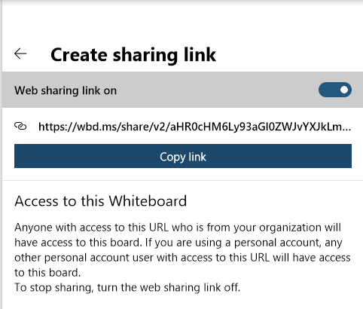
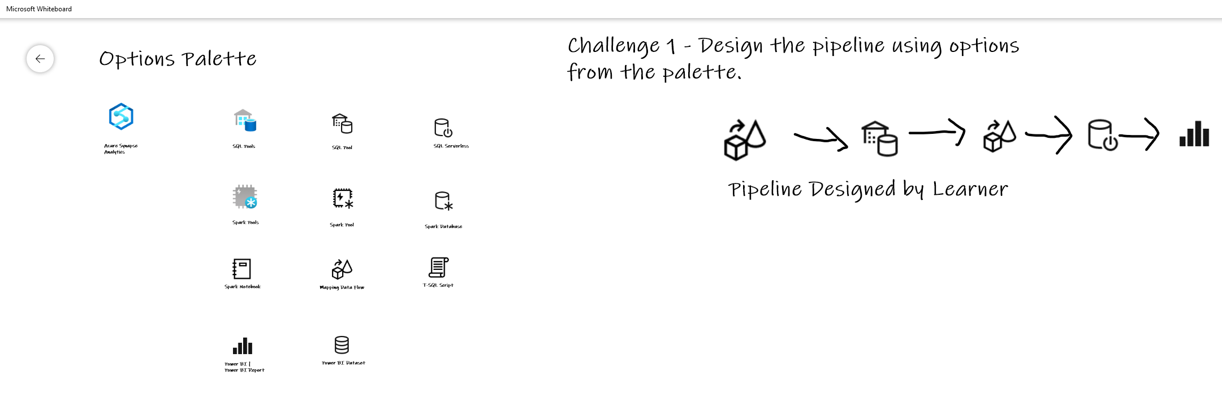

Activity: group-based whiteboard exercise
GUIDE:
Activity 01: Data Lake Design & Security Considerations
https://github.com/solliancenet/data-ai-technical-bootcamp/
Step 1: Go to your table group channel
Step 2: Your Learning Adviser will provide whiteboard & guide link
Step 3: Read guide and load the whiteboard. Begin activity collaboration with your table group via a Microsoft Teams “meet now” call (meet now button in upper right corner of application)

Slide 44
Break
Please take this time for a short 15 minute break
Relax and come back refreshed for our next activity
If at anytime you require assistance please send a message to the “Need help – ask here” channel in the Microsoft Teams site for this event

Slide 45

Hands-On Build Activity: Data Integration Part 1
Objective: As a result of participating in this lab, you will be better able to architect and deploy data integration pipelines
What you will be doing: This will be a chance for you to work individually in your lab environment to complete a set of tasks you would typically follow in work associated with ingesting and integrating your customer’s data. A set of tasks are outlined for you to follow and complete.
Total Activity Time: 45 minutes

Slide 46
DEMO: How to access your lab environment

Slide 47



Lab: individual lab exercise
Step 1: Go to your table group channel
Step 2: Your Learning Adviser will provide you a unique cloud lab login link
Step 3: Login and begin the lab. Engage your table group via a Microsoft Teams “meet now” call to support each other (meet now button in upper right corner of application)

Slide 48

Break
Please take this time for a 1-hour break
But first, a thought exchange question
Now, take time to relax and come back refreshed for our next activity
If at anytime you require assistance please send a message to the “Need help – ask here” channel in the Microsoft Teams site for this event

Slide 49
Data Transformations
CSA07P

Slide 50
Agenda
1 Preparing to transform
Understanding and exploring the data.
4 Transform with Spark
Using notebooks to query SQL Pools and transform with open source modules.
2 Apply transformations
Apply coded and code-free transformations.
5 Best practices
Best practices for data transformation.
3 Serverless transforms
Use Azure Synapse SQL Serverless to transform data with SQL scripts.

Slide 51
Typical Data Transformations
Create persistent staging area / data vault
Standardize data from different sources
Remove duplicate rows
Impute missing values
Calculate derived values
Prepare data for facts and dimensions

Slide 52
ETL vs ELT
ETL transforms the data outside the warehouse. If transformations depend on data in the warehouse, the time to move data to the ETL process can be slow. Transformations are written in the language of the ETL tool.
ELT transforms data within the warehouse. This requires all data to be loaded to the DW before transformation. All transformations are written in SQL.
ELT is almost always faster than ETL.

Slide 53
Preparing to transform – exploratory data analysis

Slide 54
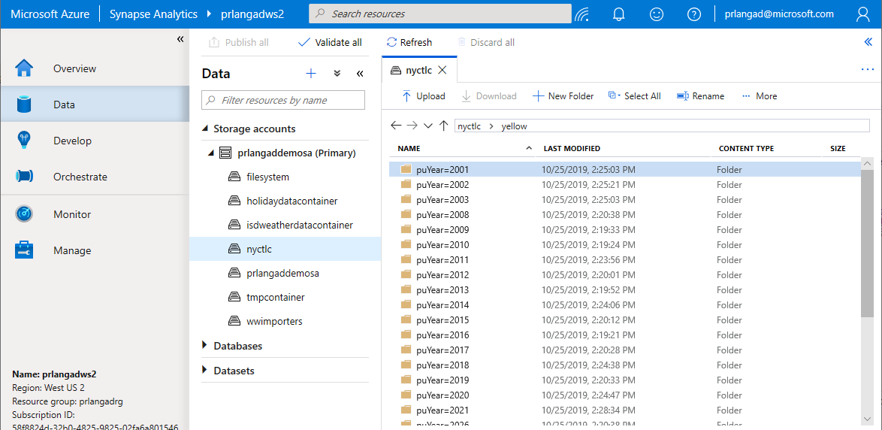
Navigating storage accounts
Browse Azure Data Lake Storage Gen2 accounts and filesystems – navigate through folders to see data
Filepath
ADLS Gen2 Account
Container (filesystem)

Slide 55
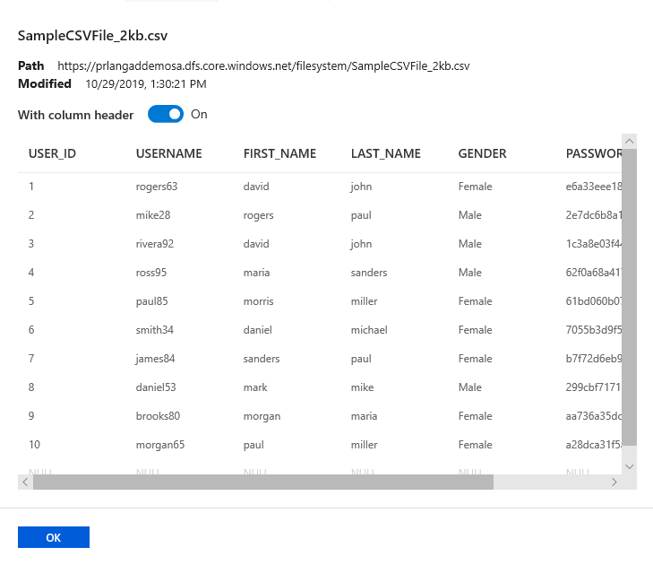
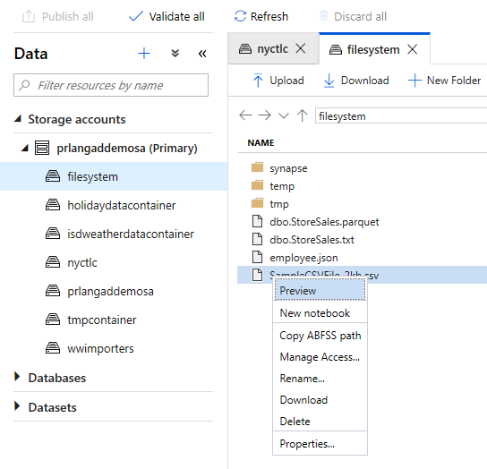
Preview CSV files in storage accounts
Preview a sample of your data

Slide 56
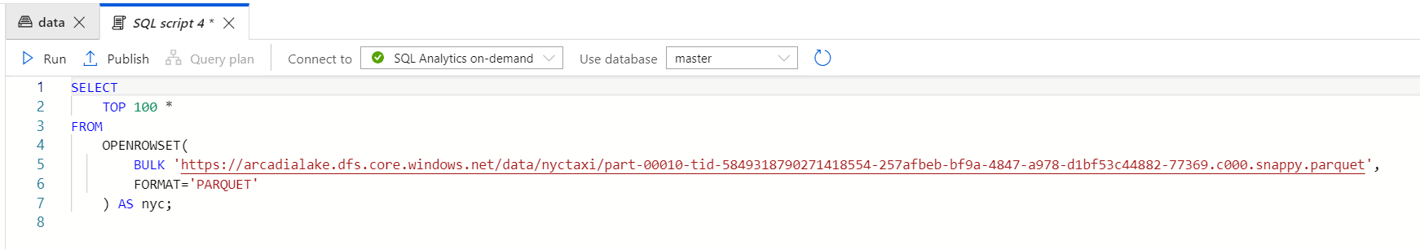
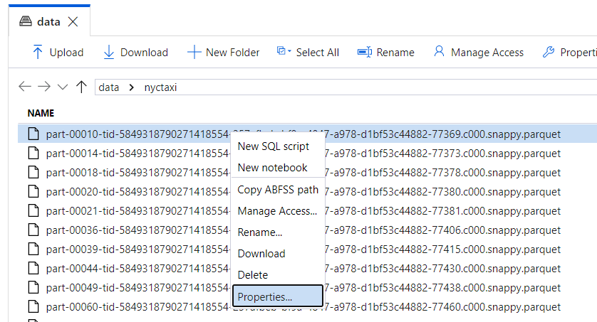
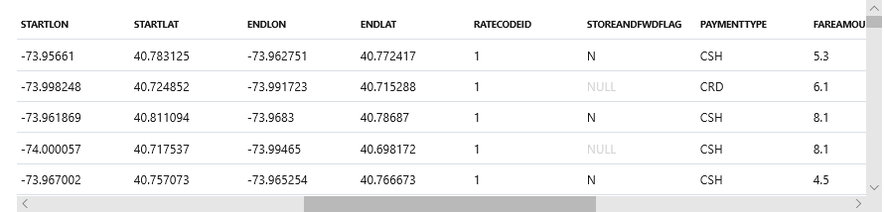
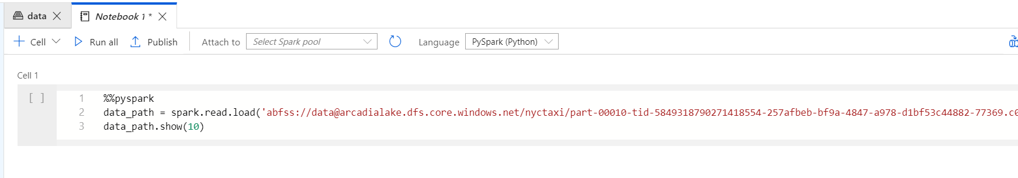
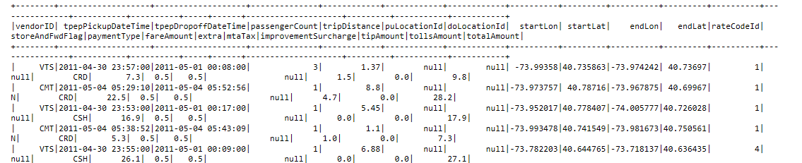
Query Parquet files in storage accounts
Two simple gestures to start analyzing with SQL scripts or with notebooks.
T-SQL or PySpark auto-generated.

Slide 57
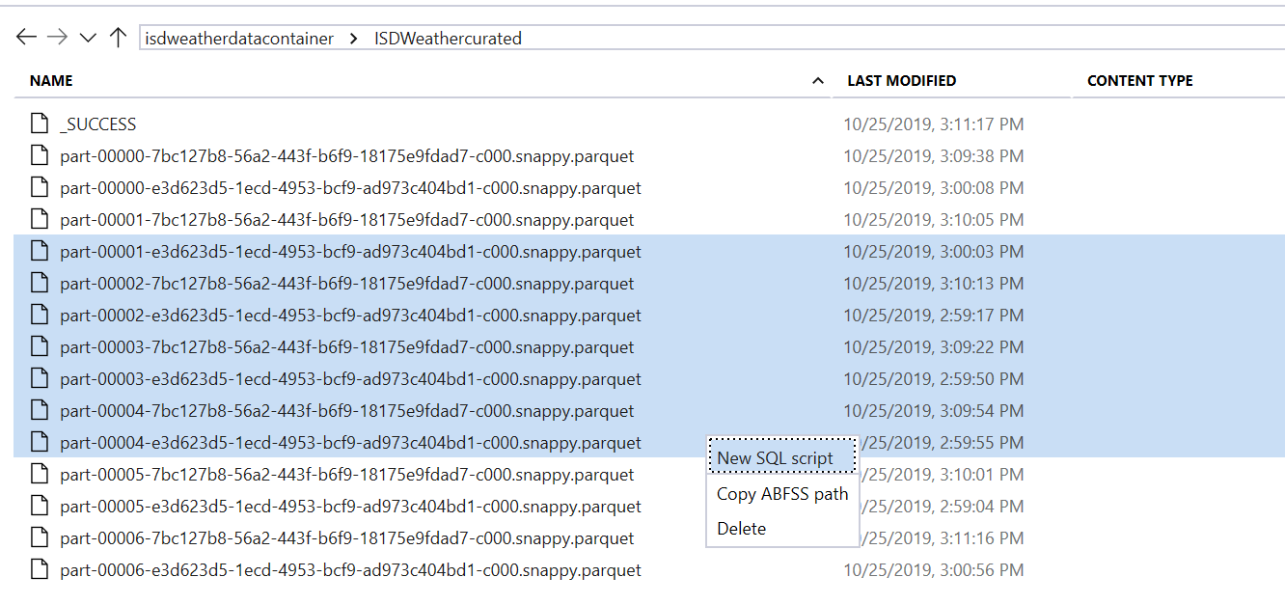
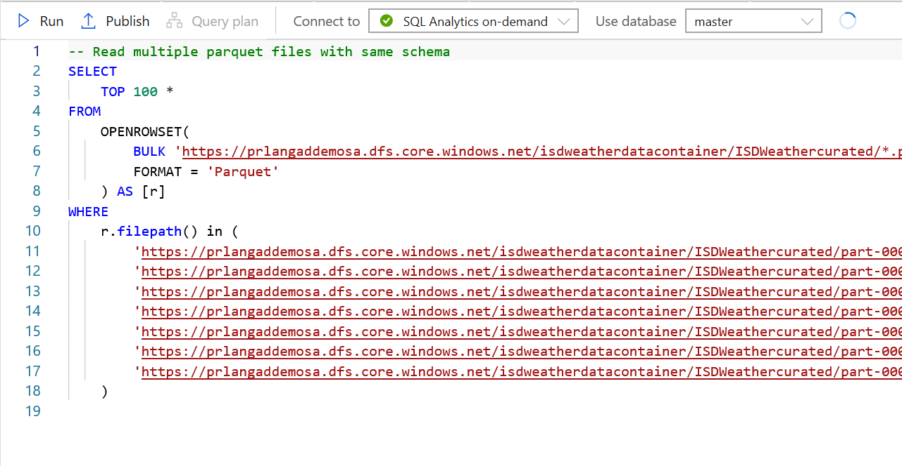
Multiple file selections supported
SQL Script from Multiple files
Multi-select of files generates a SQL script that analyzes all those files together

Slide 58
Applying transformations

Slide 59
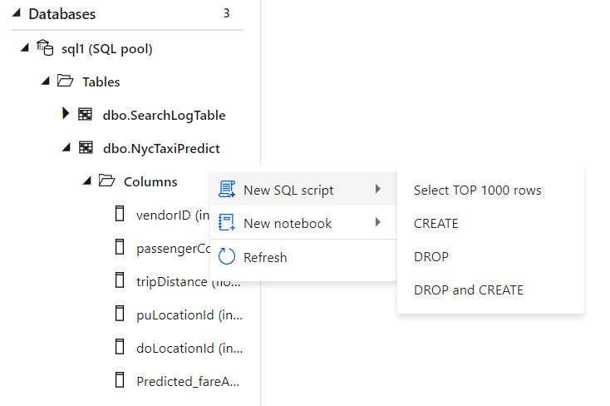
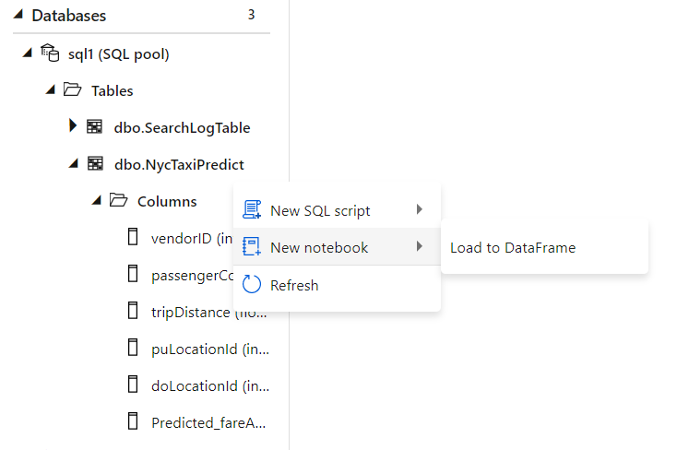
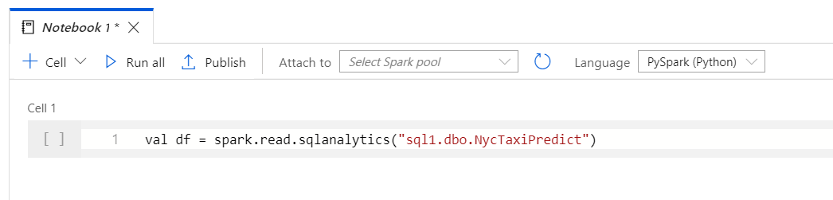
Code based transformations
Familiar gesture to generate T-SQL scripts from SQL metadata objects such as tables.
Starting from a table, auto-generate a single line of PySpark code that makes it easy to load a SQL table into a Spark dataframe​

Slide 60
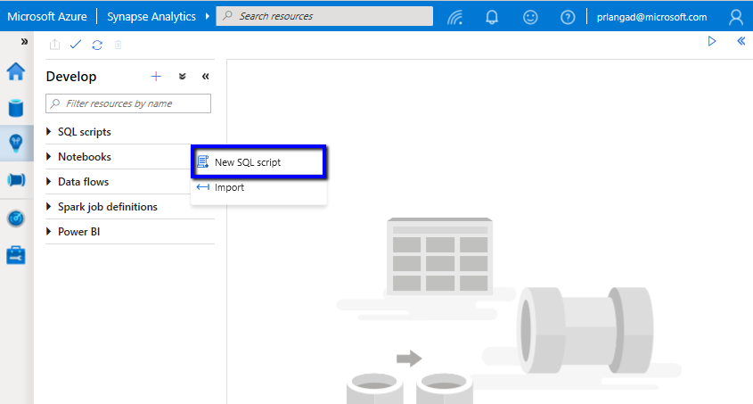
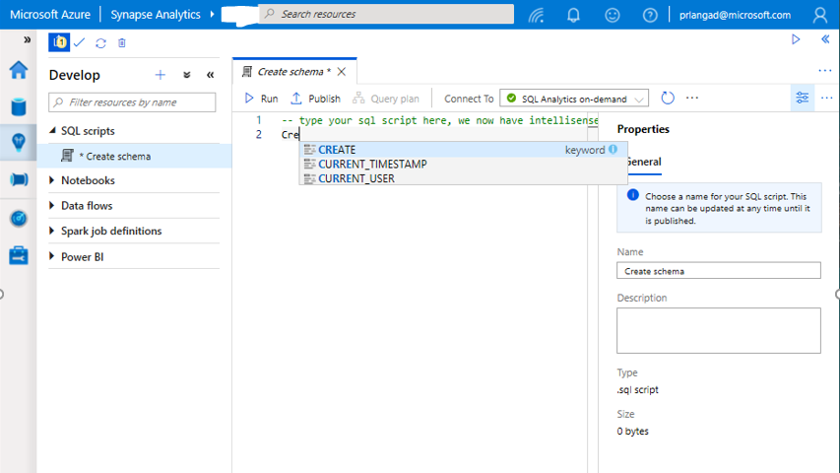
Transform with SQL script
SQL Script
Authoring SQL Scripts
Execute SQL script on provisioned SQL Pool or SQL On-demand
Publish individual SQL script or multiple SQL scripts through Publish all feature
Language support and intellisense

Slide 61
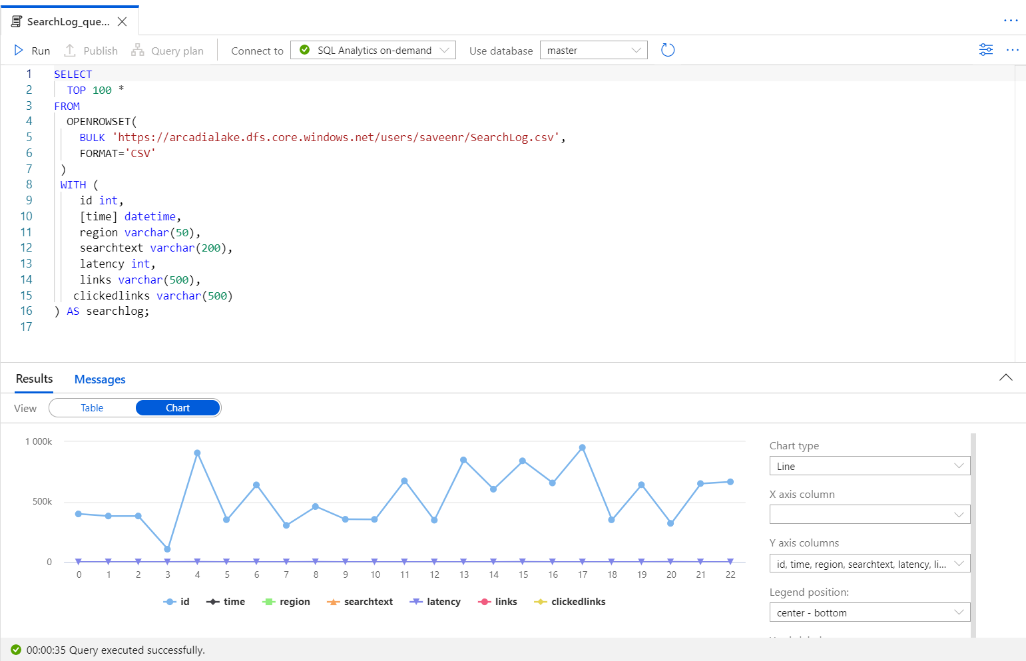
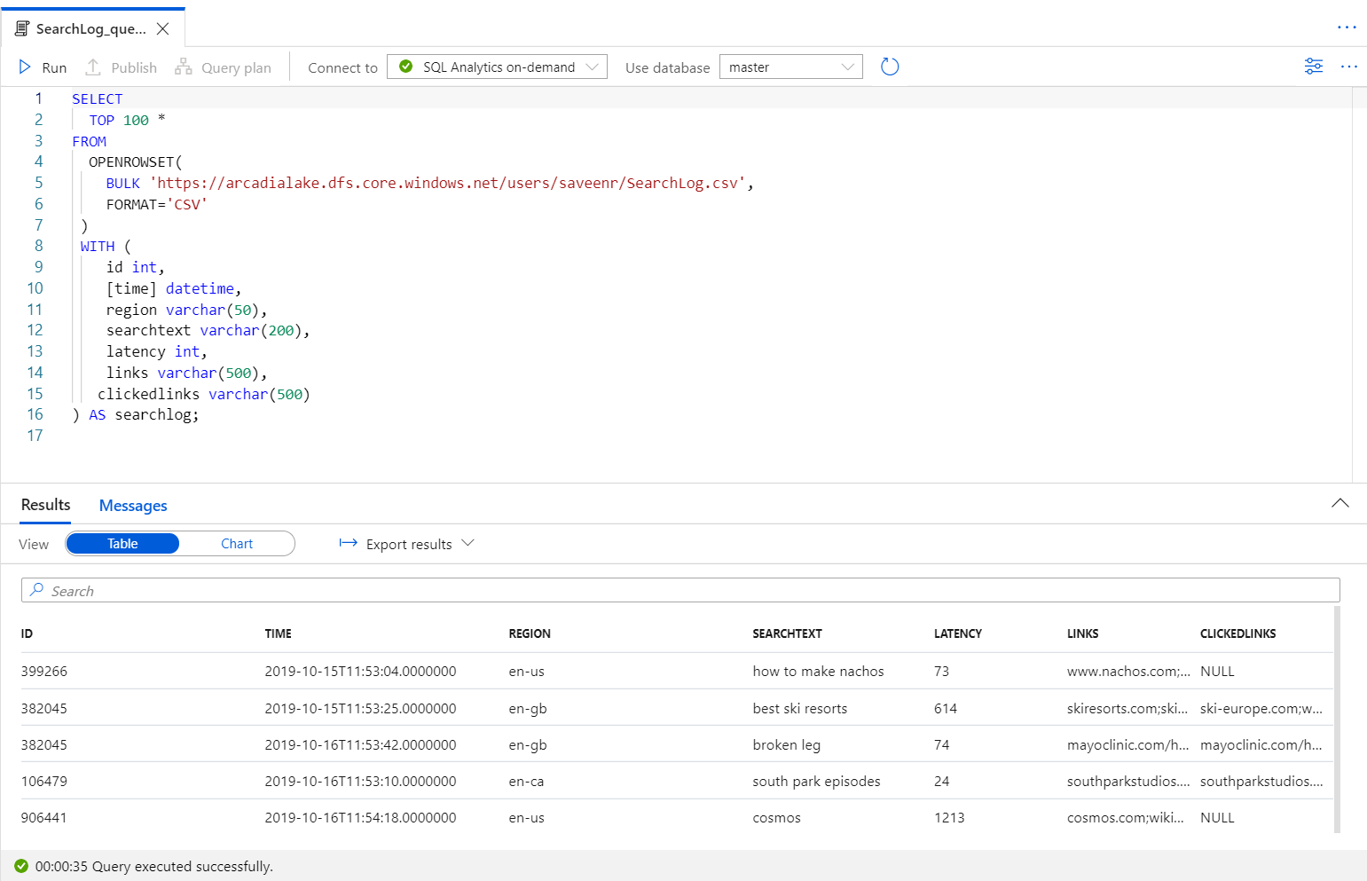
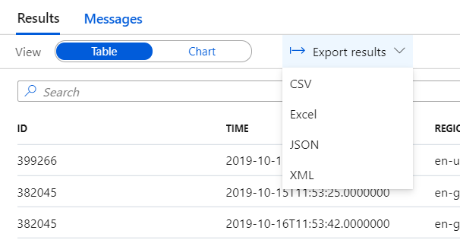

Transform with SQL script (2)
SQL Script
View results in Table or Chart form and export results in several popular formats

Slide 62
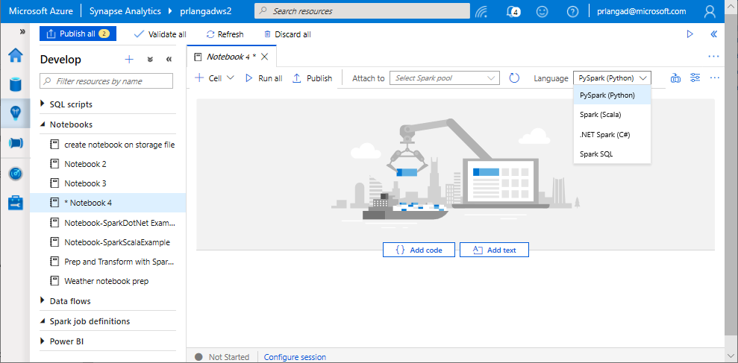
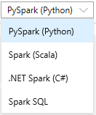
Transform with Notebooks
Notebooks
Allows to write multiple languages in one notebook
%%<Name of language>
Offers use of temporary tables across languages
Language support for Syntax highlight, syntax error, syntax code completion, smart indent, code folding
Export results

Slide 63
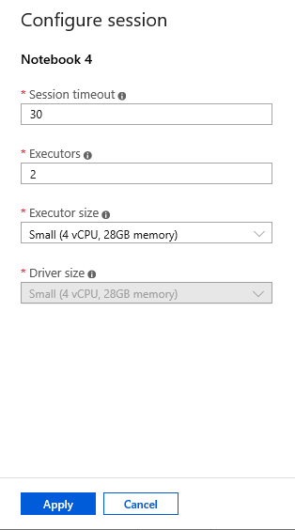
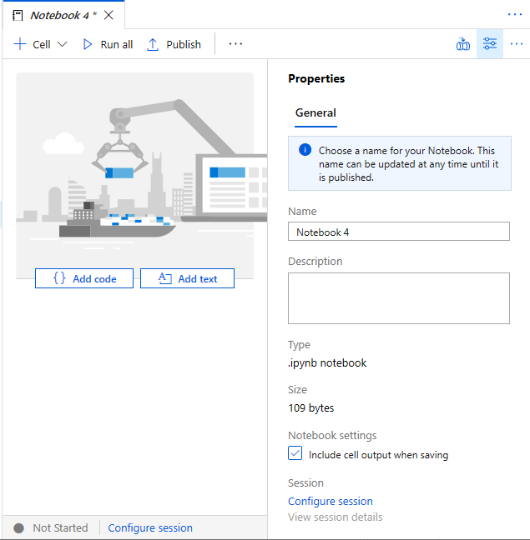
Transform with Notebooks (2)
Configure session allows developers to control how many resources are devoted to running their notebook.
Notes:
Spark pool-> spark session->
Add amount of compute

Slide 64
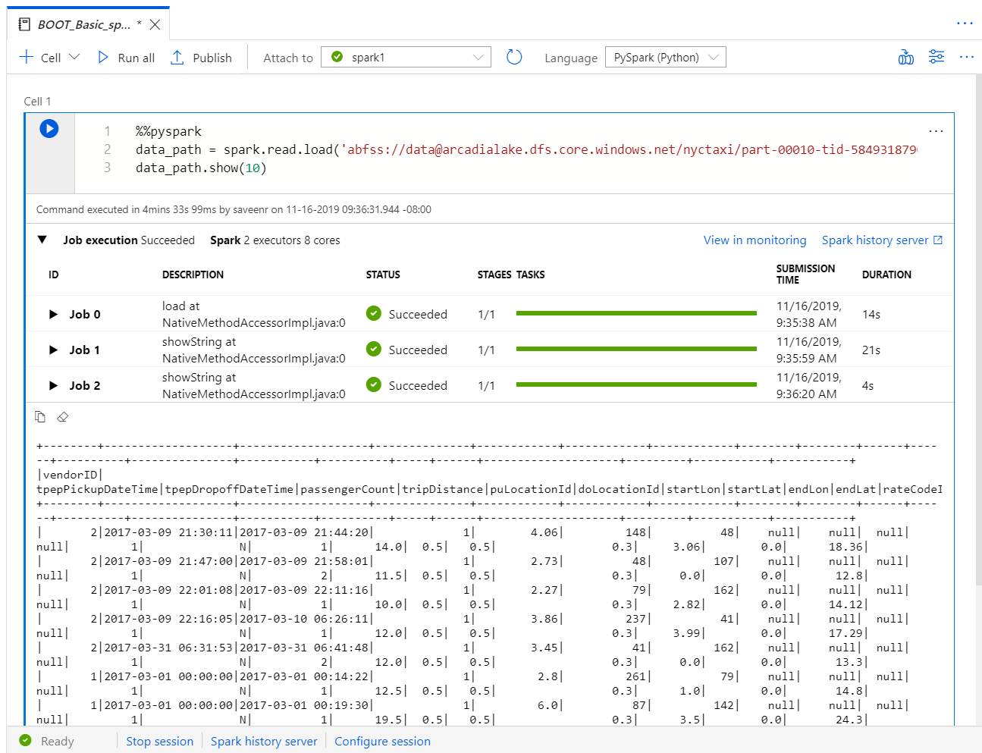
Transform with Notebooks (3)
As notebook cells run, the underlying Spark application status is shown. Providing immediate feedback and progress tracking.​

Slide 65
Transform with Pipelines
It provides ability to create pipelines to ingest, transform and load data with 90+ inbuilt connectors.
Offers a wide range of activities that a pipeline can perform.

Slide 66
Transform with Data Flows
Data flows are a visual way of specifying how to transform data.
Provides a code-free experience.

Slide 67
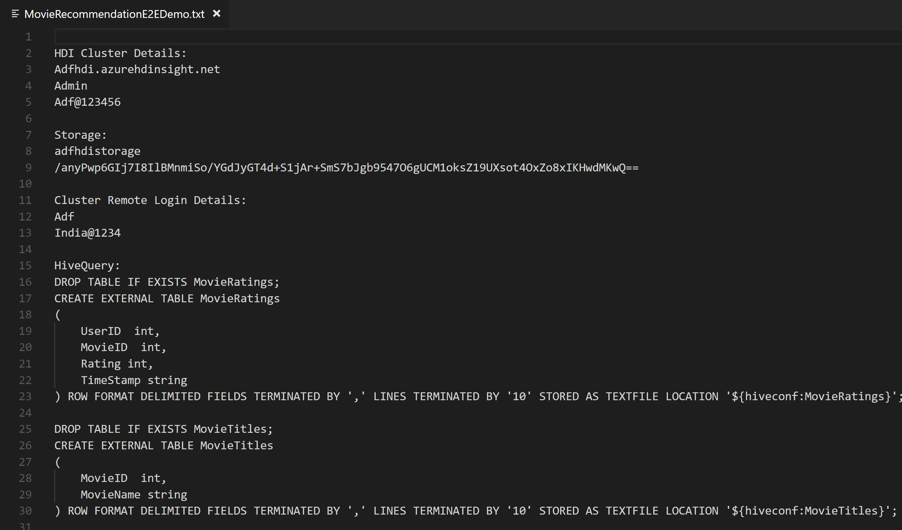
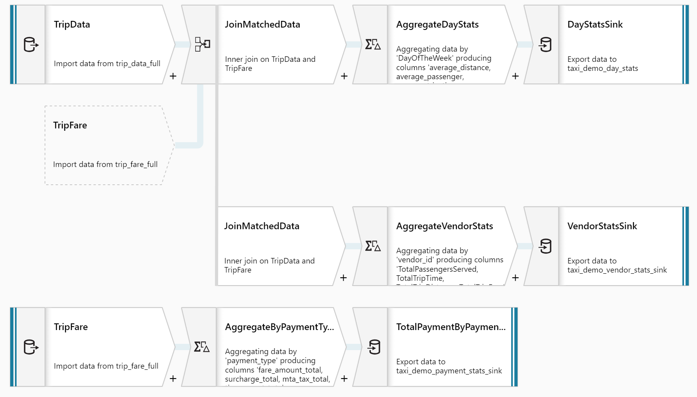
Transform with Data Flows (2)
Overview
It offers data cleansing, transformation, aggregation, conversion, etc
Benefits
Cloud scale via Spark execution
Guided experience to easily build resilient data flows
Flexibility to transform data per user’s comfort
Monitor and manage dataflows from a single pane of glass
… not

Slide 68
Transform with Serverless

Slide 69





Transform with Synapse SQL Serverless
Overview
An interactive query service that provides T-SQL queries over high scale data in Azure Storage.
Benefits
Serverless
No infrastructure
Pay only for query execution
No ETL
Offers security
Data integration with Databricks, HDInsight
T-SQL syntax to query data
Supports data in various formats (Parquet, CSV, JSON)
Support for BI ecosystem
Curate and transform data
Power BI
SQL On Demand Query
Azure Data Studio
Sync table definitions
Read and write
data files
SSMS
Read and write
data files
10
01
Azure Storage

Slide 70
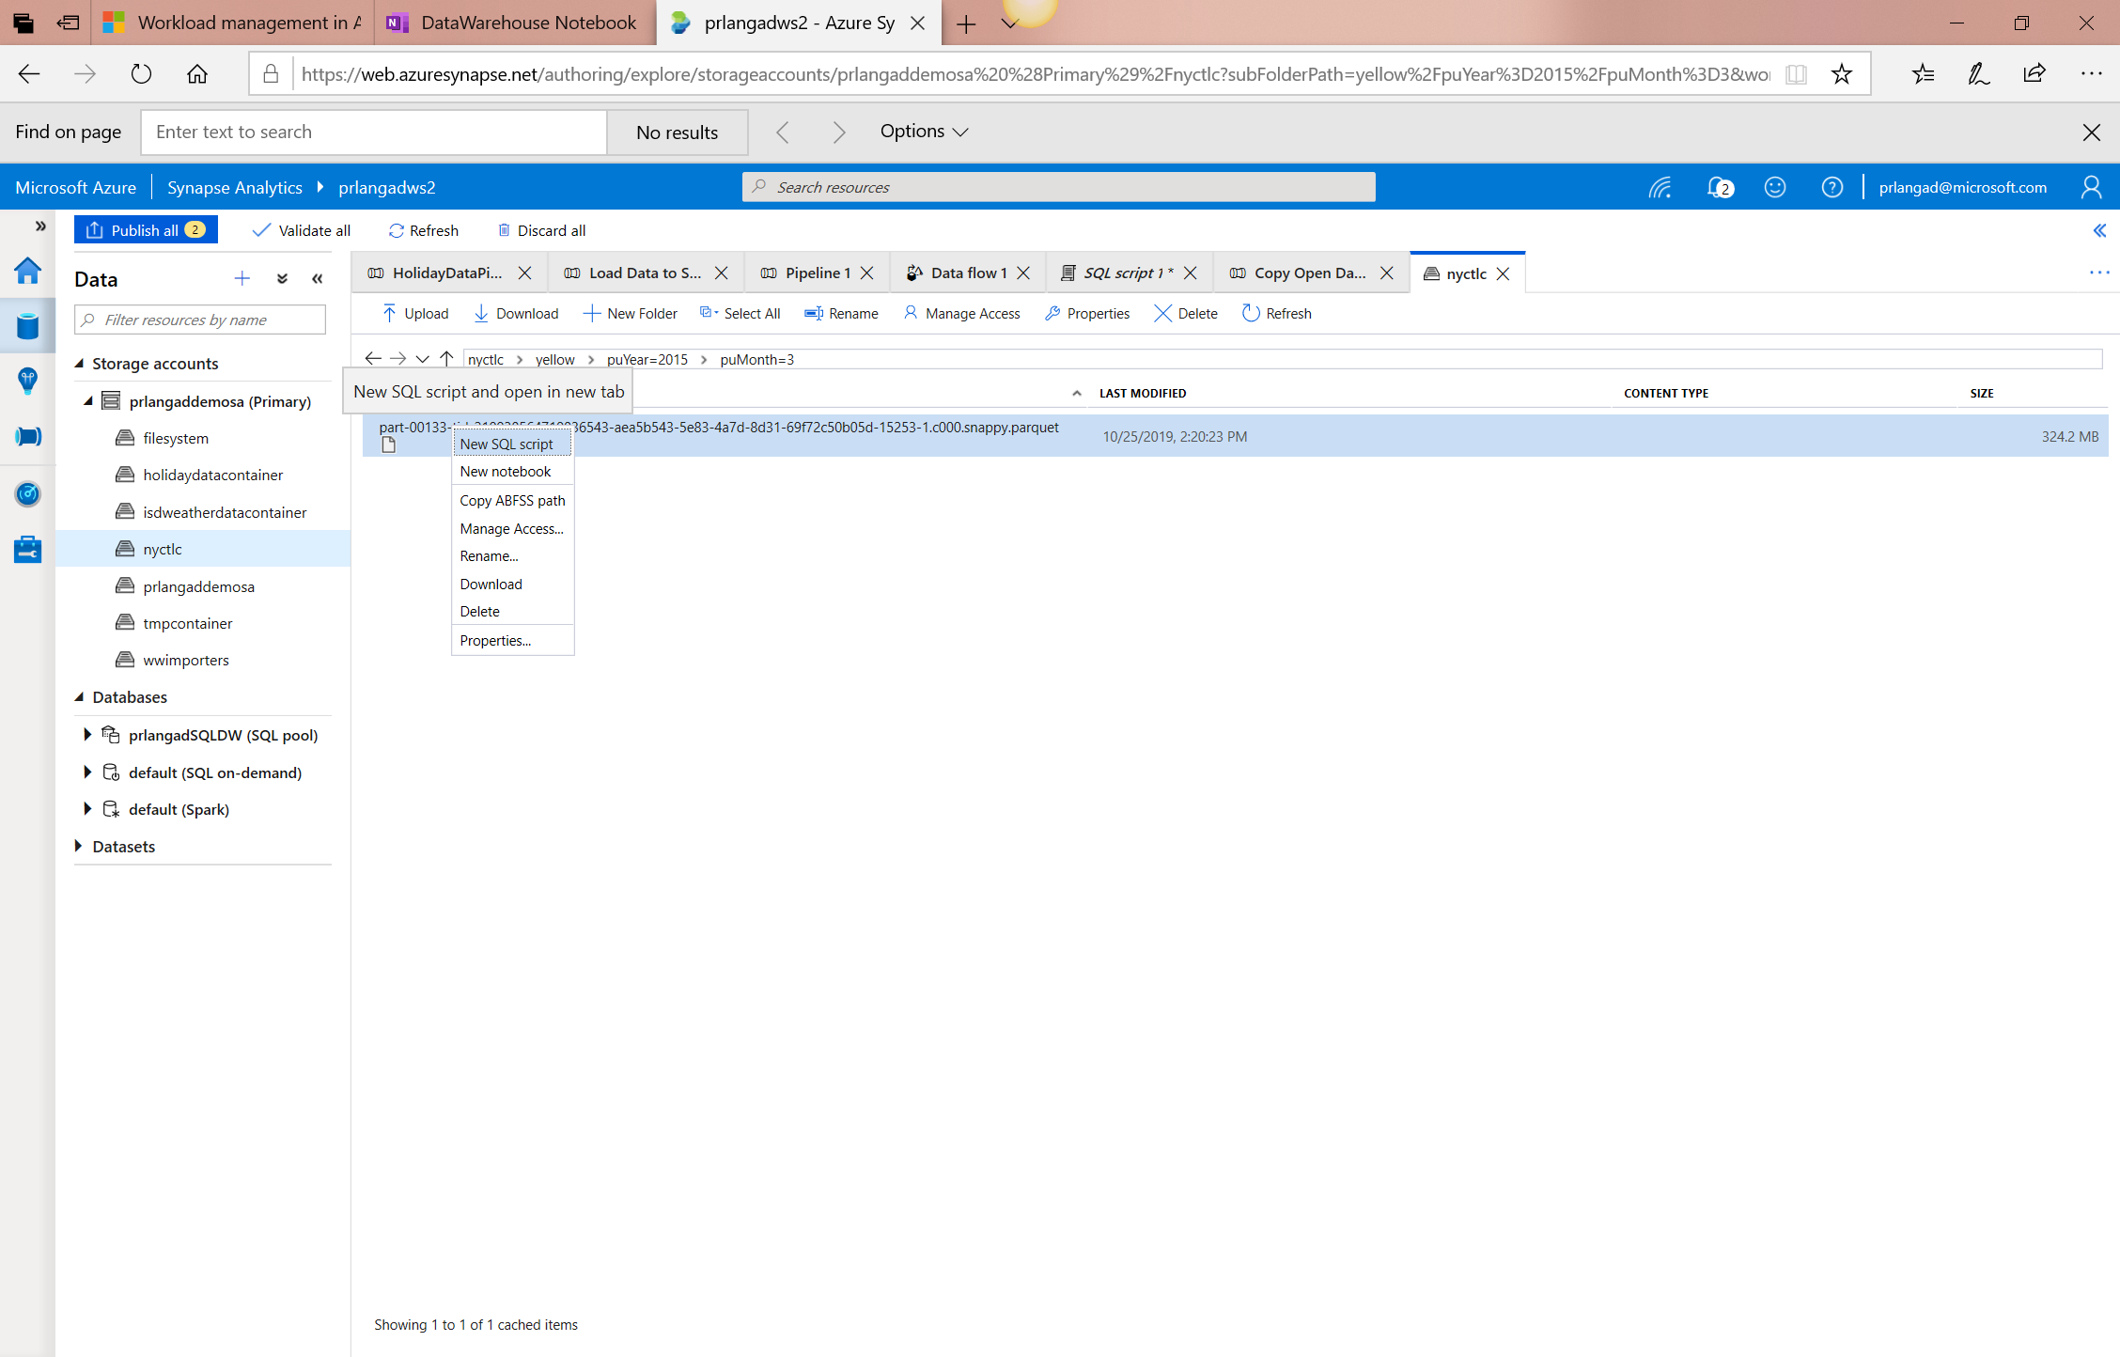
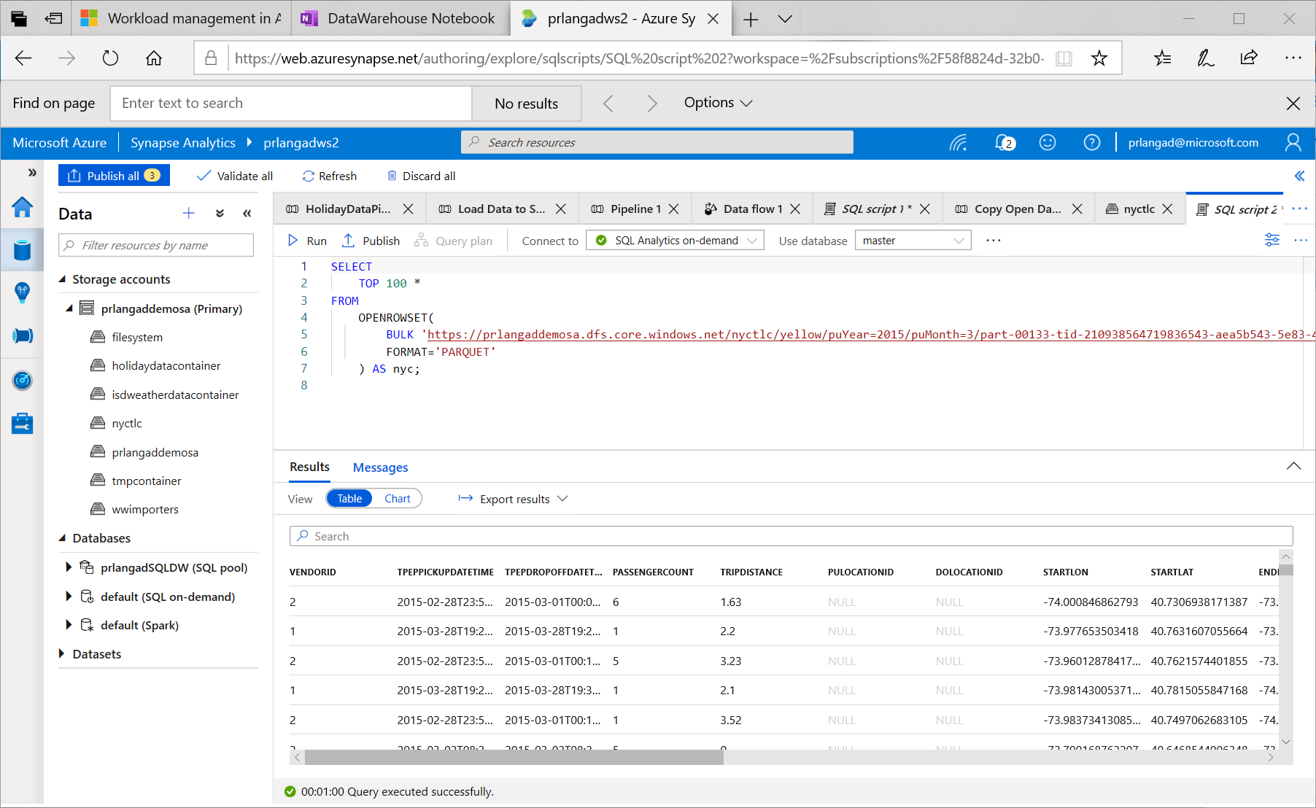
Synapse SQL Serverless – Querying on storage

Slide 71
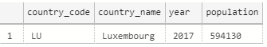
Synapse SQL Serverless – Querying CSV File
Overview
Uses OPENROWSET function to access data
Benefits
Ability to read CSV File with
- no header row, Windows style new line
- no header row, Unix-style new line
- header row, Unix-style new line
- header row, Unix-style new line, quoted
- header row, Unix-style new line, escape
- header row, Unix-style new line, tab-delimited
- without specifying all columns
SELECT *
FROM OPENROWSET(
BULK 'https://XXX.blob.core.windows.net/csv/population/population.csv',
FORMAT = 'CSV',
FIELDTERMINATOR =',',
ROWTERMINATOR = '\n'
)
WITH (
[country_code] VARCHAR (5) COLLATE Latin1_General_BIN2,
[country_name] VARCHAR (100) COLLATE Latin1_General_BIN2,
[year] smallint,
[population] bigint
) AS [r]
WHERE
country_name = 'Luxembourg'
AND year = 2017

Slide 72
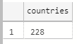
Synapse SQL Serverless – Querying CSV File
Read CSV file - header row, Unix-style new line
Read CSV file - without specifying all columns
SELECT *
FROM OPENROWSET(
BULK 'https://XXX.blob.core.windows.net/csv/population-unix-hdr/population.csv',
FORMAT = 'CSV',
FIELDTERMINATOR =',',
ROWTERMINATOR = '0x0a',
FIRSTROW = 2
)
WITH (
[country_code] VARCHAR (5) COLLATE Latin1_General_BIN2,
[country_name] VARCHAR (100) COLLATE Latin1_General_BIN2,
[year] smallint,
[population] bigint
) AS [r]
WHERE
country_name = 'Luxembourg'
AND year = 2017
SELECT
COUNT(DISTINCT country_name) AS countries
FROM OPENROWSET(
BULK 'https://XXX.blob.core.windows.net/csv/population/population.csv',
FORMAT = 'CSV',
FIELDTERMINATOR =',',
ROWTERMINATOR = '\n'
)
WITH (
[country_name] VARCHAR (100) COLLATE Latin1_General_BIN2 2
) AS [r]

Slide 73
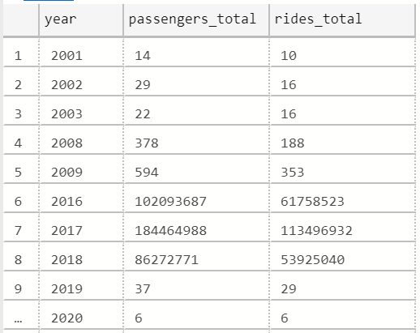
Synapse SQL Serverless – Querying folders
Overview
Uses OPENROWSET function to access data from
multiple files or folders
Benefits
Offers reading multiple files/folders through usage of wildcards
Offers reading specific file/folder
Supports use of multiple wildcards
SELECT YEAR(pickup_datetime) as [year], SUM(passenger_count) AS passengers_total, COUNT(*) AS [rides_total]
FROM OPENROWSET(
BULK 'https://XXX.blob.core.windows.net/csv/taxi/*.*’,
FORMAT = 'CSV’
, FIRSTROW = 2 )
WITH (
vendor_id VARCHAR(100) COLLATE Latin1_General_BIN2,
pickup_datetime DATETIME2,
dropoff_datetime DATETIME2,
passenger_count INT,
trip_distance FLOAT,
rate_code INT,
store_and_fwd_flag VARCHAR(100) COLLATE Latin1_General_BIN2,
pickup_location_id INT,
dropoff_location_id INT,
payment_type INT,
fare_amount FLOAT,
extra FLOAT, mta_tax FLOAT,
tip_amount FLOAT,
tolls_amount FLOAT,
improvement_surcharge FLOAT,
total_amount FLOAT
) AS nyc
GROUP BY YEAR(pickup_datetime)
ORDER BY YEAR(pickup_datetime)

Slide 74
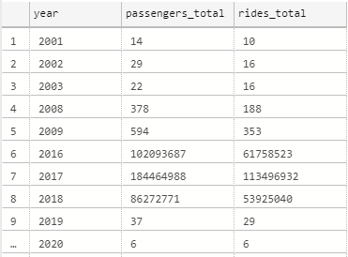
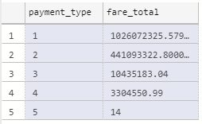
Synapse SQL Serverless – Querying folders
Read all files from multiple folders
Read subset of files in folder
SELECT YEAR(pickup_datetime) as [year],
SUM(passenger_count) AS passengers_total,
COUNT(*) AS [rides_total]
FROM OPENROWSET(
BULK 'https://XXX.blob.core.windows.net/csv/t*i/',
FORMAT = 'CSV',
FIRSTROW = 2 )
WITH (
vendor_id VARCHAR(100) COLLATE Latin1_General_BIN2,
pickup_datetime DATETIME2,
dropoff_datetime DATETIME2,
passenger_count INT,
trip_distance FLOAT,
<… columns>
) AS nyc
GROUP BY YEAR(pickup_datetime)
ORDER BY YEAR(pickup_datetime)
SELECT
payment_type,
SUM(fare_amount) AS fare_total
FROM OPENROWSET(
BULK 'https://XXX.blob.core.windows.net/csv/taxi/yellow_tripdata_2017-*.csv',
FORMAT = 'CSV',
FIRSTROW = 2 )
WITH (
vendor_id VARCHAR(100) COLLATE Latin1_General_BIN2,
pickup_datetime DATETIME2,
dropoff_datetime DATETIME2,
passenger_count INT,
trip_distance FLOAT,
<…columns>
) AS nyc
GROUP BY payment_type
ORDER BY payment_type

Slide 75
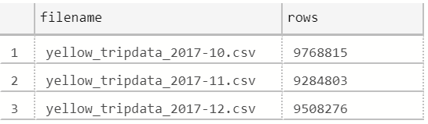
Synapse SQL Serverless – Querying specific files
Overview
filename – Provides file name that originates row result
filepath – Provides full path when no parameter is passed or part of path when parameter is passed that originates result
Benefits
Provides source name/path of file/folder for row result set
Example of filename function
SELECT
r.filename() AS [filename]
,COUNT_BIG(*) AS [rows]
FROM OPENROWSET(
BULK 'https://XXX.blob.core.windows.net/csv/taxi/yellow_tripdata_2017-1*.csv’,
FORMAT = 'CSV',
FIRSTROW = 2
)
WITH (
vendor_id INT,
pickup_datetime DATETIME2,
dropoff_datetime DATETIME2,
passenger_count SMALLINT,
trip_distance FLOAT,
<…columns>
) AS [r]
GROUP BY r.filename()
ORDER BY [filename]

Slide 76
Synapse SQL Serverless – Querying specific files
Example of filepath function
SELECT
r.filepath() AS filepath
,r.filepath(1) AS [year]
,r.filepath(2) AS [month]
,COUNT_BIG(*) AS [rows]
FROM OPENROWSET(
BULK 'https://XXX.blob.core.windows.net/csv/taxi/yellow_tripdata_*-*.csv’,
FORMAT = 'CSV',
FIRSTROW = 2 )
WITH (
vendor_id INT,
pickup_datetime DATETIME2,
dropoff_datetime DATETIME2,
passenger_count SMALLINT,
trip_distance FLOAT,
<… columns>
) AS [r]
WHERE r.filepath(1) IN ('2017’)
AND r.filepath(2) IN ('10', '11', '12’)
GROUP BY r.filepath() ,r.filepath(1) ,r.filepath(2)
ORDER BY filepath
filepath | year | month | rows
https://XXX.blob.core.windows.net/csv/taxi/yellow_tripdata_2017-10.csv | 2017 | 10 | 9768815
https://XXX.blob.core.windows.net/csv/taxi/yellow_tripdata_2017-11.csv | 2017 | 11 | 9284803
https://XXX.blob.core.windows.net/csv/taxi/yellow_tripdata_2017-12.csv | 2017 | 12 | 9508276

Slide 77

Synapse SQL Serverless – Querying Parquet files
Overview
Uses OPENROWSET function to access data
Benefits
Ability to specify column names of interest
Offers auto reading of column names and data types
Provides target specific partitions using filepath function
SELECT
YEAR(pickup_datetime),
passenger_count,
COUNT(*) AS cnt
FROM
OPENROWSET(
BULK 'https://XXX.blob.core.windows.net/parquet/taxi/*/*/*',
FORMAT='PARQUET'
) WITH (
pickup_datetime DATETIME2,
passenger_count INT
) AS nyc
GROUP BY
passenger_count,
YEAR(pickup_datetime)
ORDER BY
YEAR(pickup_datetime),
passenger_count

Slide 78

Synapse SQL Serverless – Querying JSON files
Overview
Read JSON files and provides data in tabular format
Benefits
Supports OPENJSON, JSON_VALUE and JSON_QUERY functions
SELECT *
FROM
OPENROWSET(
BULK 'https://XXX.blob.core.windows.net/json/books/book1.json’,
FORMAT='CSV',
FIELDTERMINATOR ='0x0b',
FIELDQUOTE = '0x0b',
ROWTERMINATOR = '0x0b'
)
WITH (
jsonContent varchar(8000)
) AS [r]

Slide 79
Synapse SQL Serverless – Querying JSON files
Example of JSON_VALUE function
Example of JSON_QUERY function
SELECT
JSON_VALUE(jsonContent, '$.title') AS title,
JSON_VALUE(jsonContent, '$.publisher') as publisher,
jsonContent
FROM
OPENROWSET(
BULK 'https://XXX.blob.core.windows.net/json/books/*.json',
FORMAT='CSV',
FIELDTERMINATOR ='0x0b',
FIELDQUOTE = '0x0b',
ROWTERMINATOR = '0x0b'
)
WITH (
jsonContent varchar(8000)
) AS [r]
WHERE
JSON_VALUE(jsonContent, '$.title') = 'Probabilistic and Statistical Methods in Cryptology, An Introduction by Selected Topics'
SELECT
JSON_QUERY(jsonContent, '$.authors') AS authors,
jsonContent
FROM
OPENROWSET(
BULK 'https://XXX.blob.core.windows.net/json/books/*.json',
FORMAT='CSV',
FIELDTERMINATOR ='0x0b',
FIELDQUOTE = '0x0b',
ROWTERMINATOR = '0x0b'
)
WITH (
jsonContent varchar(8000)
) AS [r]
WHERE
JSON_VALUE(jsonContent, '$.title') = 'Probabilistic and Statistical Methods in Cryptology, An Introduction by Selected Topics'

Slide 80
Transform with Spark

Slide 81
Transforming with Spark – Querying SQL Pools
Existing Approach
New Approach Using Scala
val jdbcUsername = "<SQL DB ADMIN USER>"
val jdbcPwd = "<SQL DB ADMIN PWD>"
val jdbcHostname = "servername.database.windows.net”
val jdbcPort = 1433
val jdbcDatabase ="<AZURE SQL DB NAME>“
val jdbc_url = s"jdbc:sqlserver://${jdbcHostname}:${jdbcPort};database=${jdbcDatabase};encrypt=true;trustServerCertificate=false;hostNameInCertificate=*.database.windows.net;loginTimeout=60;“
val connectionProperties = new Properties()
connectionProperties.put("user", s"${jdbcUsername}")
connectionProperties.put("password", s"${jdbcPwd}")
val sqlTableDf = spark.read.jdbc(jdbc_url, “dbo.Tbl1", connectionProperties)
// Construct a Spark DataFrame from SQL Pool table
var df = spark.read.sqlanalytics("sql1.dbo.Tbl1")
// Write the Spark DataFrame into SQL Pool table
df.write.sqlanalytics(“sql1.dbo.Tbl2”)
Using Python
%%spark
val df = spark.read.sqlanalytics("sql1.dbo.Tbl1")
df.createOrReplaceTempView("tbl1")
%%pyspark
sample = spark.sql("SELECT * FROM tbl1")
sample.createOrReplaceTempView("tblnew")
%%spark
val df = spark.sql("SELECT * FROM tblnew")
df.write.sqlanalytics(“sql1.dbo.tbl2", Constants.INTERNAL)
Notes:
Important Points:
No need to pre-create the table in the SQL Pool to write to, it will be created if it does not exist.
sqlanalytics only works in Scala language cells.
To read with other languages like Python, use Spark to register a temporary view and then query the view using Spark.SQL(“select * from viewname”)
To write with other languages, create a view for table you want write, then query from that view in Scala. Then write.

Slide 82

View results in table format

Slide 83

SQL support
View results in chart format

Slide 84

Exploratory data analysis with graphs – histogram, boxplot etc

Slide 85

Library Management - Python
In the Portal Specify the new requirements while creating Spark Pool in Additional Settings blade
Overview
Add new python libraries at Spark pool level
Benefits
Input requirements.txt in simple pip freeze format
Add new libraries to your cluster
Update versions of existing libraries on your cluster
Libraries will get installed for your Spark pool during cluster creation
Ability to specify different requirements file for different pools within the same workspace
Constraints
The library version must exist on PyPI repository
Version downgrade of an existing library not allowed

Slide 86

Library Management - Python
Get list of installed libraries with version information

Slide 87
Best practices

Slide 88
CCI vs Heap
Transformations using Heap tables are generally faster than CCI. This is because rows need to be assembled from column stores on read tables, and columnar compression is needed on targets.
The wider the table, and the more text fields it contains, the faster Heap is over CCI.
Use Heap tables at transformation layer, use CCI tables where appropriate at presentation layer

Slide 89
CCI Best Practice
MAX data types not supported
At least 60million rows * number of partitions
At least 100k rows per batch, up to 1million
Load using at least LARGERC or STATICRC60
Minimal UPDATE and DELETE (or REBUILD frequently)

Slide 90
Statistics
Do not rely on auto statistics at this time. Auto statistics are created, but never updated. This leads to poor performance as a table changes
Manually create statistics on columns used in JOIN, GROUP BY and ORDER BY clauses
Update statistics after every major update to a table
Failure to maintain current statistics WILL lead to bad performance

Slide 91
CTAS vs Insert / Update / Delete / Merge
Prefer CTAS when you update or delete more than 10% of rows
Prefer CTAS when you are updating or deleting a clustered Columnstore index, and do not have time for an offline rebuild

Slide 92
UPDATE FROM and DELETE FROM
Azure Synapse Analytics does not currently support (*) joins in UPDATE FROM and DELETE FROM queries.
Implement the join as a temporary / transient table, then UPDATE / DELETE from that table
(*) Coming soon

Slide 93
Simple is better than clever
Persist standard columns early, to avoid calculations and functions in WHERE clause
Unroll CTEs and JOIN sub-selects to transient / temporary tables to manage distribution
Simple queries are easier to tune and debug

Slide 94
Thank You slide
Thank you

Slide 95

Full Group Activity: Data Engineering Discussion
Objective: As a result of participating in this activity, you will better be able to decide on which Azure Synapse Analytics component to use for specific data engineering scenarios.
What you will be doing: The facilitator will be posting questions to the entire group using an interactive tool called Mentimeter. The answers you post using Mentimeter will then drive the Data Engineering Discussion.
Total Activity Time: 30 minutes

Slide 96
Mentimeter Poll

Slide 97
Hands-On Build Activity: Data Integration Part 2
Objective: As a result of participating in this lab, you will be better able to build data pipelines that integrate disparate data sources and handle poorly formatted data during ingestion.
What you will be doing: Like the Part 1 exercise, you work individually in your lab environment to complete a set of tasks you would typically follow in work associated with ingesting and integrating your customer’s data. A set of tasks are outlined for you to follow and complete.
Total Activity Time: 60 minutes

Slide 98
Lab: individual lab exercise
Step 1: Go to your table group channel
Step 2: Your Learning Adviser will provide you a unique cloud lab login link
Step 3: Login and begin the lab. Engage your table group via a Microsoft Teams “meet now” call to support each other (meet now button in upper right corner of application)

Slide 99

Day 1 Wrap Up
Thank you for your participation in the Day 1 Technical Boot Camp
What was covered today:
Design, optimize, and secure a file system within ALDS Gen2
Decide on which Azure Synapse Analytics component to use for specific data engineering scenarios
What we will learn tomorrow:
Implement optimization strategizes for data warehouse using SQL
Apply security concepts to a customer scenario
If at anytime you require assistance please send a message to the “Need help – ask here” channel in the Microsoft Teams site for this event

